Slide 1
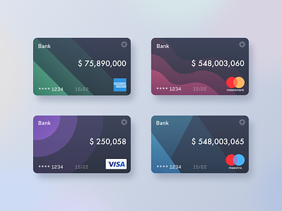
Credit Card Data Insights

Slide 2
Project Objective:
To develop a comprehensive weekly dashboard for credit card operations that delivers actionable data insights into key performance metrics and trends, thereby enabling stakeholders to effectively monitor, analyze, and make data-driven decisions about credit card performance and operations.

Slide 3
Data Source:
Get Data from MySQL database:
Credit Card Transaction db.
Credit card Customer db.
Additional data of Week 53 (185 rows) for both db.

Slide 4
Dax Queries:
1. Create a new column "Age_Group" to categorize Age in different groups
Age_Group = SWITCH(TRUE(),
'ccdb customer'[Customer_Age]<31,"0-30",
'ccdb customer'[Customer_Age]>=31 && 'ccdb customer'[Customer_Age]<41,"31-40",
'ccdb customer'[Customer_Age]>=41 && 'ccdb customer'[Customer_Age]<51,"41-50",
'ccdb customer'[Customer_Age]>=51 && 'ccdb customer'[Customer_Age]<61,"51-60",
'ccdb customer'[Customer_Age]>=61,"61-100","unknown"
)
2. Create a new column "Income_Group" to categorize Income in different groups
Income_Group = SWITCH(TRUE(),
'ccdb customer'[Income]<35000,"Low",
'ccdb customer'[Income]>=35000 && 'ccdb customer'[Income]<70000,"Medium",
'ccdb customer'[Income]>=70000,"High","unknown"
)
3. Create a new column "Revenue"
Revenue = 'ccdb credit_card'[Annual_Fees]+'ccdb credit_card'[Interest_Earned]
4. Create a new measure "Previous_Week_Revenue"
Previous_week_revenue = CALCULATE(SUM('ccdb credit_card'[Revenue]),'ccdb credit_card'[Week_Num]=MAX('ccdb credit_card'[Week_Num])-1)
5. Create a new measure "WOW_Revenue" (Week on Week percentage)
WOW_Revenue = DIVIDE((CALCULATE(SUM('ccdb credit_card'[Revenue]))-[Previous_week_revenue]),[Previous_week_revenue])

Slide 5
Project Insights:
Week-on-Week data insights:
• Revenue increased by 3%,
• Total Transaction Amt & Count increased by 35% & 0.21%
• Customer count increased by 13%
Overall data insights:
• Overall revenue is 11M
• Total interest is 8M
• Total transaction amount is 46M
• Total transaction count is 667K
• Highest Card usage during swipe (65%)
• 85% of revenue generated by Blue Card
• Top 3 expenditure types are Bills, Entertainment, and Fuel
• Max revenue generated by Businessman customer (28.76%)
• Male customers are contributing more in revenue: Male-5.6M, Female-5.4M
• Average Income of Customer is 57K
• Average Age of Customer is 46
• Average Customer satisfaction rate is 3.19
• 47.56% revenue generated by the Customers of High Income group
• 27 week is the highest peek of revenue throughout the year and its 240K
• Card activation rate is 57.46%
• Delinquent Account rate is 6.06%

Slide 6
Thank You

